Slide 1

DATA ANALYST PORTFOLIO PROJECT
Q-Commerce Analytics
2015 performance deep dive
Subham Halder
Excel
PostgreSQL
Power BI

Slide 2
BUSINESS CONTEXT
Business Context & Objectives
Analyzing customer behavior, revenue, delivery operations and dark-store performance in a quick-commerce environment.
OBJECTIVES
Measure overall business performance
Identify major revenue drivers
Evaluate delivery & failure performance
Identify high-risk dark stores

Slide 3
PROJECT SCOPE
Dataset & Project Scope
2015
Year
100,000
Orders
8
Cities
499
Dark Stores
10
Categories
3
User Types
3
Order Statuses
27
Columns (cleaned)
Synthetic dataset
No customer_id

Slide 4
PROJECT WORKFLOW
Data & Analytical Workflow
Excel / Power Query
Raw CSV
PostgreSQL
SQL Analysis
Power BI
Business Insights
Excel / Power Query
PostgreSQL / SQL
Power BI
Cleaning & preparation of the raw dataset before analysis
Validation, exploration, KPIs and business-question analysis
Data model, DAX measures and the interactive dashboard

Slide 5
HEADLINE METRICS
Overall Business Performance
₹22.23M
Revenue
100,000
Orders
₹245.56
AOV
90.54%
Delivery Rate
9.46%
Failure Rate
3.98
Average Rating
90.54% of orders were delivered, while 9.46% were cancelled or returned

Slide 6
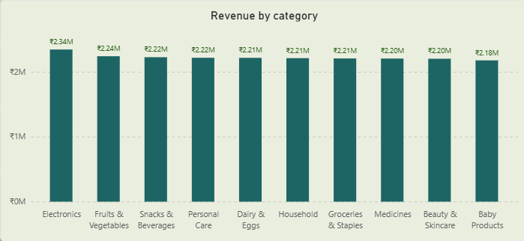
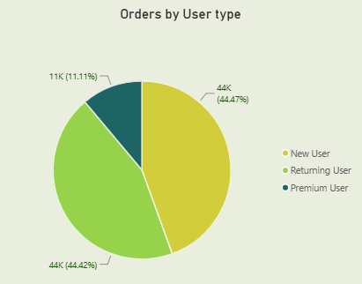
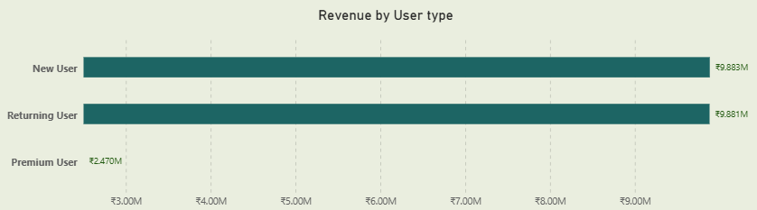
FINDINGS
Revenue & Customer Analysis
REVENUE CUSTOMER
Electronics generated the highest revenue
New Users generated the highest revenue
Fruits & Vegetables had the highest order volume
Premium Users had the highest AOV, though differences across segments were small
Electronics had the highest AOV
Premium Users had substantially higher recorded historical activity
SUPPORTING VISUALS (INSERT FROM DASHBOARD)

Slide 7
FINDINGS
Discount & Delivery Analysis
DISCOUNT DELIVERY
₹42.65
Lower AOV on discounted orders vs non-discounted
Weak positive relationship ……………….between distance and delivery ……………….time
60+ minute slot has the highest ……………….average delivery time
Discount strategy should be optimized, ……………….not broadly expanded
An analytical observation, not a standalone operational issue

Slide 8
FINDINGS
City-Level Analysis
HIGHEST REVENUE
Delhi
HIGHEST AOV
Hyderabad
HIGHEST ORDER VOLUME
Ahmedabad
HIGHEST FAILURE RATE
Chennai
SPOTLIGHT – CHENNAI
Wrong address is the leading failure reason
No single city leads across every metric – performance should be evaluated by dimension, not by one overall ranking

Slide 9
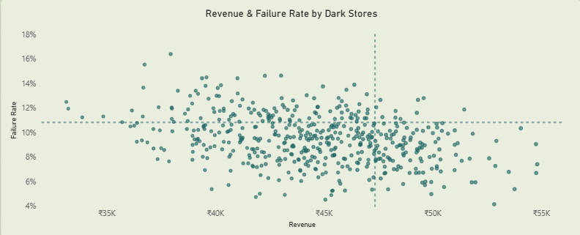
FINDINGS
Dark Store Analysis
10 stores
Above the 75th percentile for both revenue & failure rate
DS0056
highest
cancellation rate
DS0158
highest cancellation rate among stores with at least average order volume
DS0157
highest
average delivery time

Slide 10
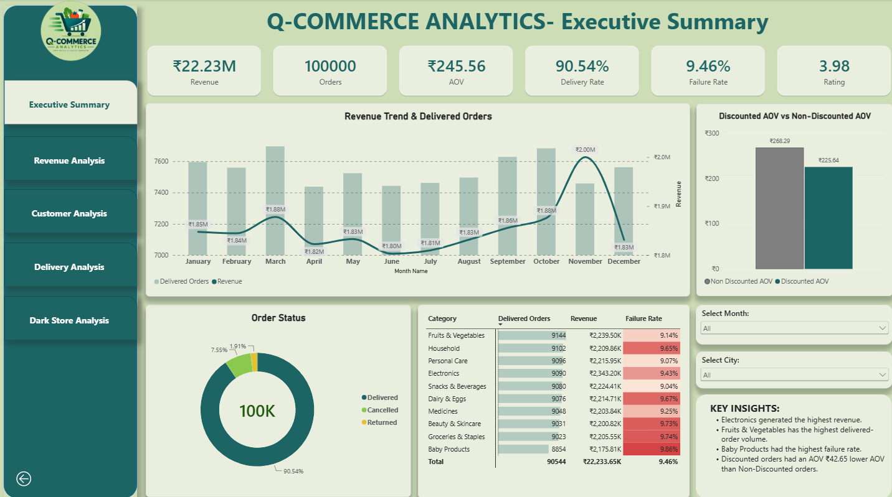
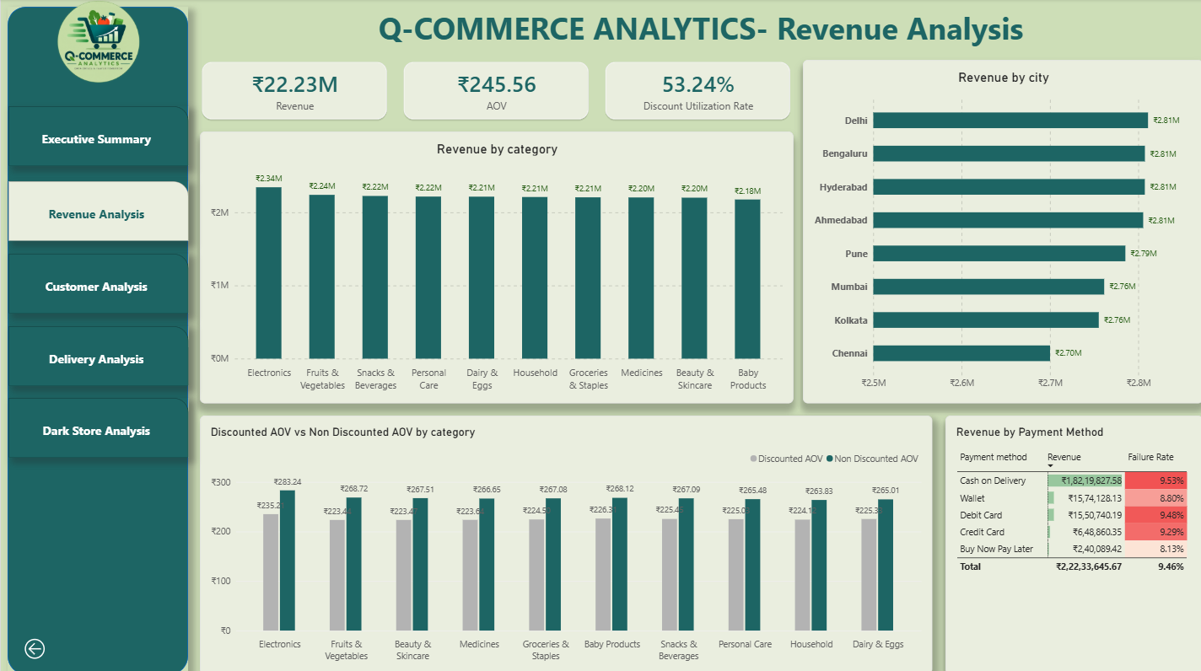
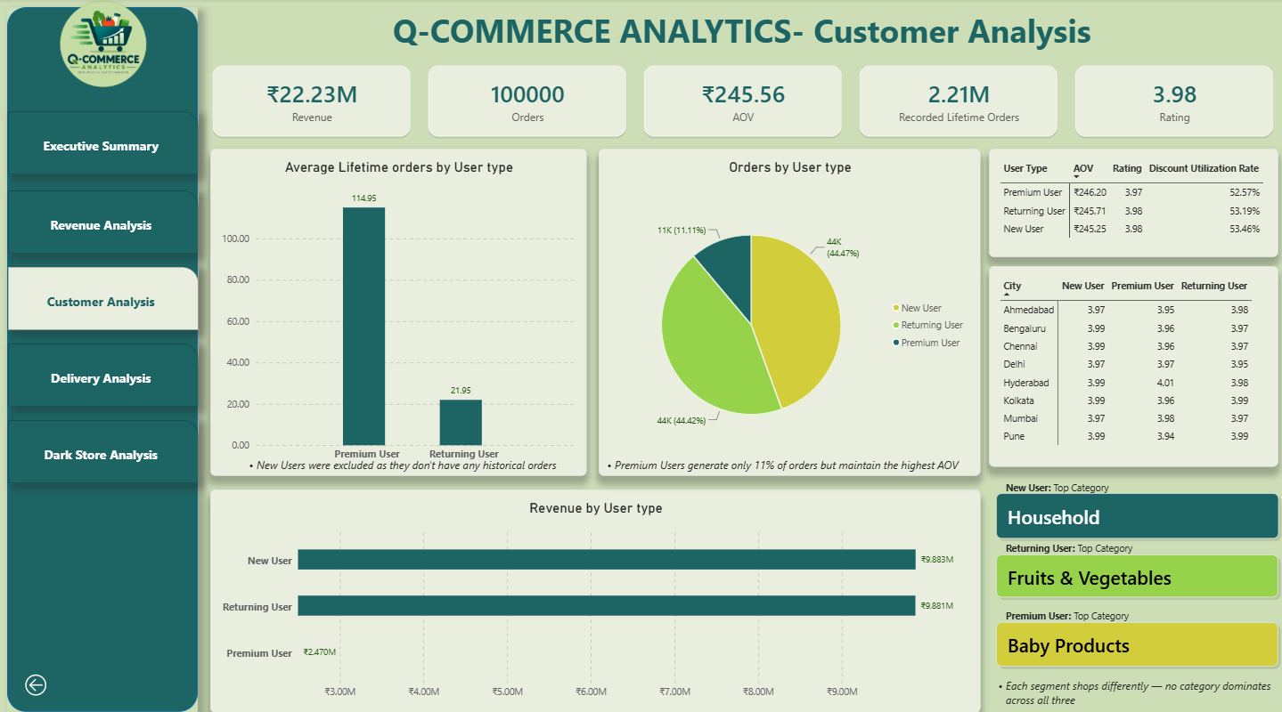
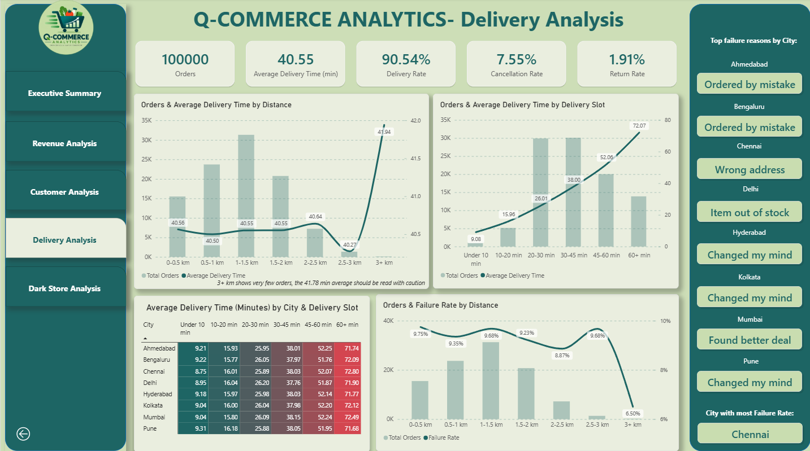
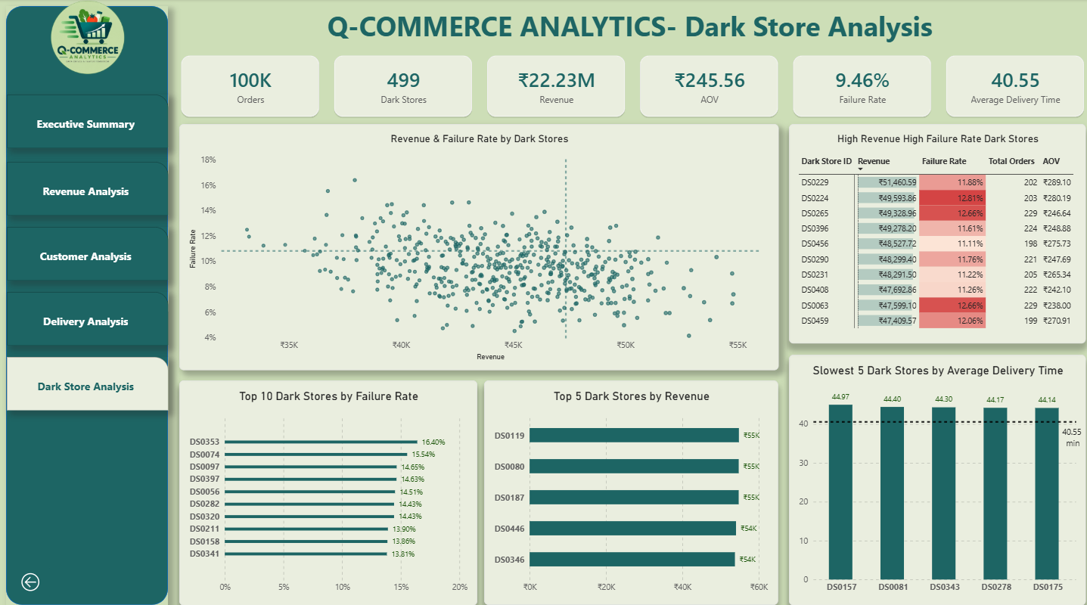
THE PRODUCT
Power BI Dashboard
Executive Summary Revenue Analysis Customer Analysis Delivery Analysis Dark Store Analysis
WHAT MAKES IT INTERACTIVE
Interactive slicers
Cross-filtering
Page navigation
DAX KPIs
Date hierarchy

Slide 11
NEXT STEPS
Key Recommendations
High-revenue + high-failure stores
Investigate and prioritize these stores for corrective action
HIGH
Chennai wrong-address failures
Improve address validation and delivery-address confirmation
HIGH
Discount strategy
Targeted promotions & minimum-order thresholds, monitoring AOV and revenue
Medium
Store-level delivery bottlenecks
Investigate stores with materially higher delivery times
Medium
City-specific failure interventions
Target interventions according to the dominant failure reason in each city
Medium

Slide 12
CLOSING
Conclusion & Future Scope
CONCLUSION FUTURE SCOPE
The 2015 analysis identified a relatively balanced revenue and customer-spending structure while highlighting operational issues across selected dark stores and cities. Chennai's elevated failure rate, particularly wrong-address failures, and high-revenue/high-failure dark stores represent key areas for operational attention. Discount strategy can also be optimized based on the observed AOV difference.
2015 → 2025 planned dataset extension
Year over year revenue
AOV trends
Category & city growth
Failure rate trends
Customer segment
Dark store performance
Thank You
Subham Halder . Q-Commerce Analysis - 2015

